Slide 1
DRAW2LIFE
Sketch to Realistic Image
“Why draw it yourself when you can confuse an algorithm?”
Presented By :-
Jyoti Dixit

Slide 2
BUSINESS PROBLEM
Sketches are intuitive but lack realism.
Artist, designers, students often struggle to bring rough images to life.
Increased Cost and time-consuming.

Slide 3
INDUSTRY INSIGHTS
Over 4.2B images shared daily on digital platforms.
Rapid growth in Generative AI: Expected to hit $66.6B by 2030.
Popular tools like MidJourney and DALL-E show strong user demand

Slide 4
MARKET GAPS
Tools exist for text-to-image, few for sketch-to-life
Lack of accessible tools for non-programmers

Slide 5
PRODUCT OVERVIEW

Slide 6
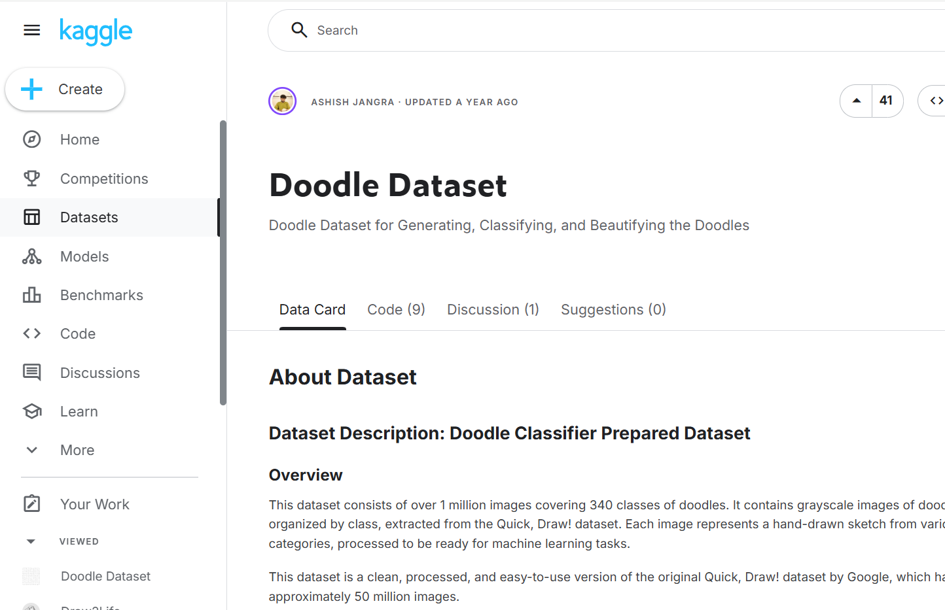
DATASET
📁 Source: Kaggle – Doodle Dataset
📦 Size: Approximately 5.5 GB
🗂️ Structure:
Contains over 300 folders
Each folder includes ~3000+ images
🎨 Content Description:
Hand-drawn doodles and sketches
Each folder represents a distinct object category (e.g., cat, airplane, tree)

Slide 7
BLIP – Image Captioning Model
What is BLIP?
Bootstrapped Language – Image Pretraining
Generates captions from images.
Pretrained on large-scale image-text pairs.
Architecture
Vision Transformer (ViT) as image encoder.
Transformer-based text decoder.
Querying Transformer for image-text interaction.
Role in Project
Converts sketch into a meaningful caption.
Caption is refined and used as a prompt for
image generation.
Model | Description | Pros | Cons
CLIP + GPT-2 | CLIP encodes image, GPT-2 generates text | Flexible, open-source | Requires custom integration
ViLT | Vision-and-Language Transformer | Lightweight, fast | Lower accuracy on captioning
GIT (Google) | Generative Image-to-Text | High-quality captions | Heavier model, less open
Flamingo (DeepMind) | Few-shot vision-language model | Very powerful | Proprietary, not open-source
BLIP-2 | Successor to BLIP with better performance | More accurate, supports LLMs | Heavier, newer model

Slide 8
Caption Refinement
🔍 Purpose
Improve the quality and relevance of prompts used for image generation.
Remove sketch-related or instructional phrases from BLIP-generated captions.
🔄 Steps
Convert caption to lowercase.
Remove phrases like:
"how to draw a"
"drawing of a"
Construct prompt for Stable Diffusion:
"A high-resolution realistic photo of {refined_caption}"
🎯 Why It Matters
Raw captions may contain irrelevant or instructional text.
Clean prompts lead to better image generation results.
Ensures the generated image matches the intended subject.

Slide 9
Stable Diffusion
🔍 Purpose
Generate realistic images from refined text prompts derived from doodle/sketch captions.
⚙️ How It Works in the Project
Receives a cleaned caption from BLIP.
Constructs a prompt: "A high-resolution realistic photo of {refined_caption}"
Uses the prompt to generate a realistic image via Stable Diffusion.
🧠 Model Details
Version: runwayml/stable-diffusion-v1.5
Framework: HuggingFace diffusers
Device: GPU (if available) for faster inference
Model | Pros | Cons
DALL·E 2 (OpenAI) | Very creative and coherent images | Closed-source, limited access
Midjourney | Artistic and stylized outputs | Not open-source, subscription-based
Imagen (Google) | State-of-the-art quality | Not publicly available
Kandinsky (by DeepFloyd) | Good for abstract and artistic styles | Less community adoption than Stable Diffusion

Slide 10
Gradio UI – Interactive Interface
🧠 Purpose
Provide a simple and interactive web interface for users to upload sketches and view results.
Connects the backend ML pipeline (BLIP + Stable Diffusion) with a user-friendly frontend.
🖼️ UI Features
Image Upload: Accepts doodles/sketches as input.
Caption Display: Shows the BLIP-generated caption.
Image Output: Displays the realistic image generated by Stable Diffusion.
🎯 Why Gradio?
Minimal setup for deploying ML models.
Real-time interaction with model outputs.
Built-in support for image and text components.
Easily shareable via public links or local hosting.

Slide 11
EXPERIMENTS AND METRICS
Performance Metrics:
Image Generation Time :
On GPU : ~3-5 mins
On CPU : ~6-8 mins

Slide 12
CHALLENGES AND SOLUTIONS
Challenge | Impact | Solution | Outcome
Caption Accuracy | BLIP occasionally misunderstood abstract sketches | Applied prompt cleaning by removing phrases like “drawing of a” | Increased accuracy
Image Quality | Stable Diffusion v1 sometimes generated blurry or off-theme images | Refined textual prompt and used v1.5 instead of v1 | Output quality significantly improved
GPU Requirements | Slow image generation on CPU: user experience lagged | Enabled GPU compatibility | Reduced image generation time from 6-8 mins to 3-4 mins
Large Dataset (~5.5GB) | Difficult to process and train over entire data volume efficiently | Created python script to sample 10 representative images from each folder | Reduced processing size and time by over 90%

Slide 13
FUTURE IMPROVEMENTS
Vision : “Turn your imagination into reality from any device”
Next Steps:
Add model tuning for precise image generation
Enhance prompt cleaning logic using NLP
Package as a mobile/web app for creators

Slide 14
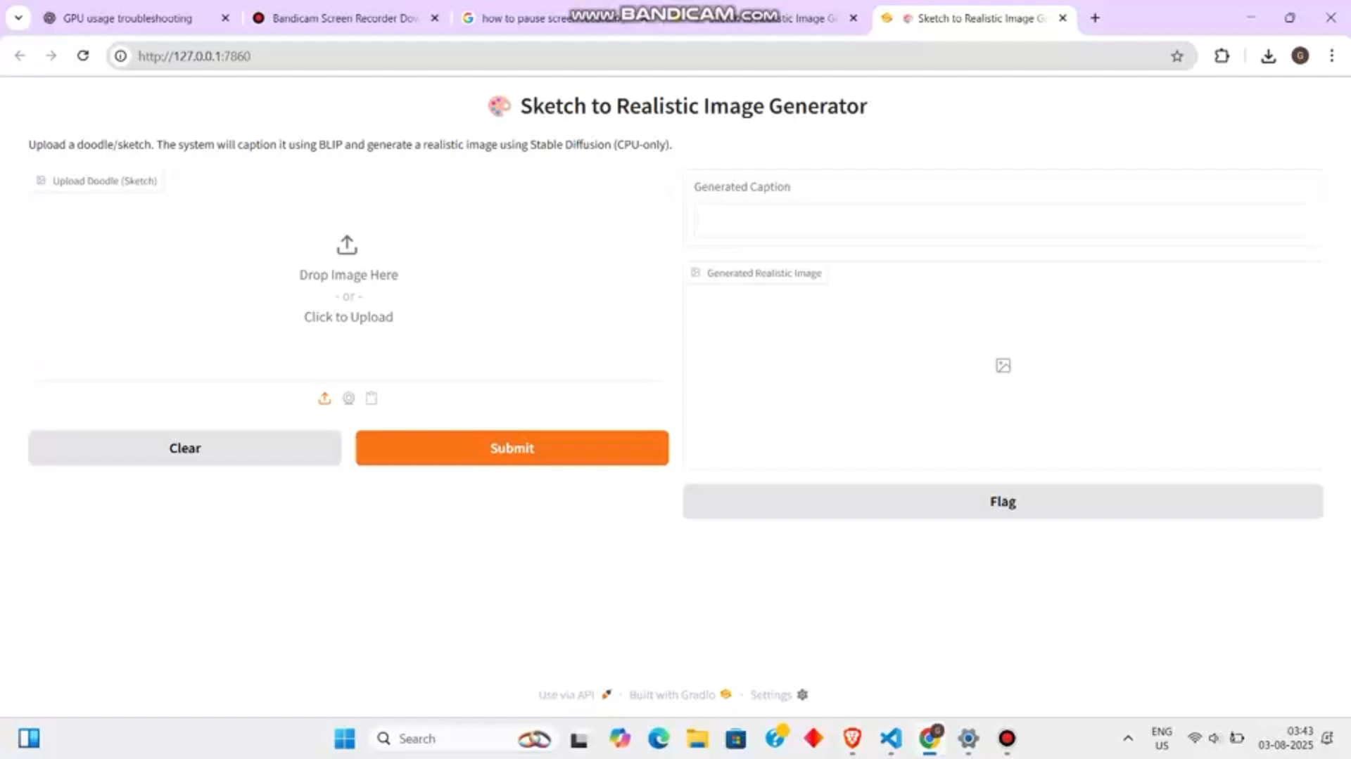
Demo of Draw2Life

Slide 15
Thank you
“Harnessing AI to turn Idea into visuals”

